Slide 1
Idea for carabid beetle shape data
10/24/2023

Slide 2
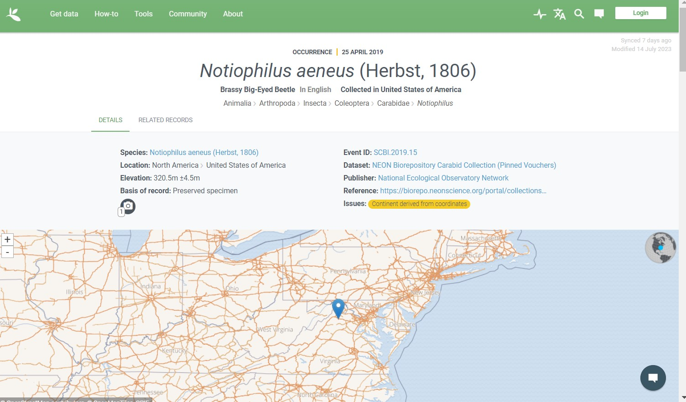
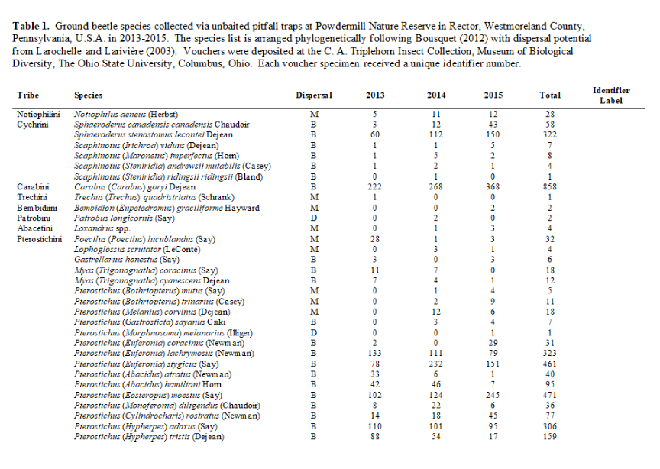
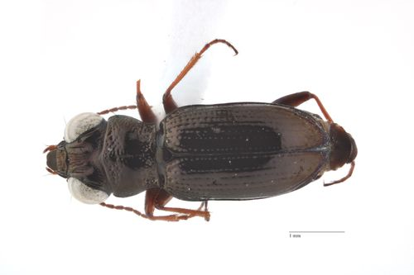
Find dorsal image on GBIF from museum records:
Compile list of species:

Slide 3
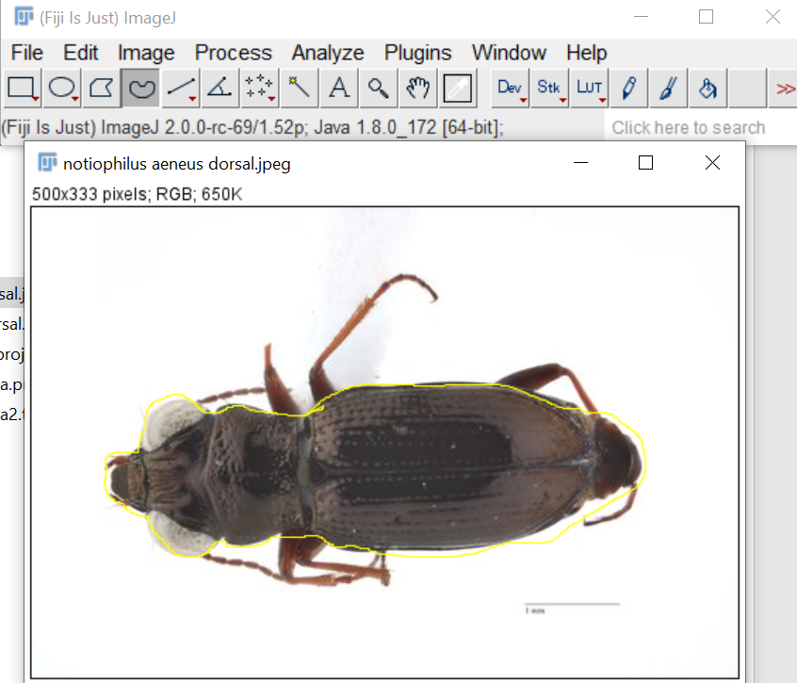
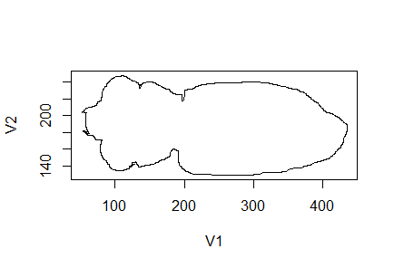
Generate outline in ImageJ:
Open in R:

Slide 4
Use R package “hangler” to do a Fourier shape analysis
Output is a set of coefficients describing the shape of the outline
Reference material:
Haines, A. John, and James S. Crampton. “Improvements To The Method Of Fourier Shape Analysis As Applied In Morphometric Studies.” Palaeontology 43, no. 4 (October 2000): 765–83. https://doi.org/10.1111/1475-4983.00148.

Slide 5
Hypotheses for body shape:
The front trochanters should be bigger for species which push themselves through the leaf litter, compared with those which walk or run on the surface (Bauer and Kredler 1993)
Antennae usually shorter in visual hunters, longer in tactile hunters
Eyes are more binocular in visual hunters

Slide 6
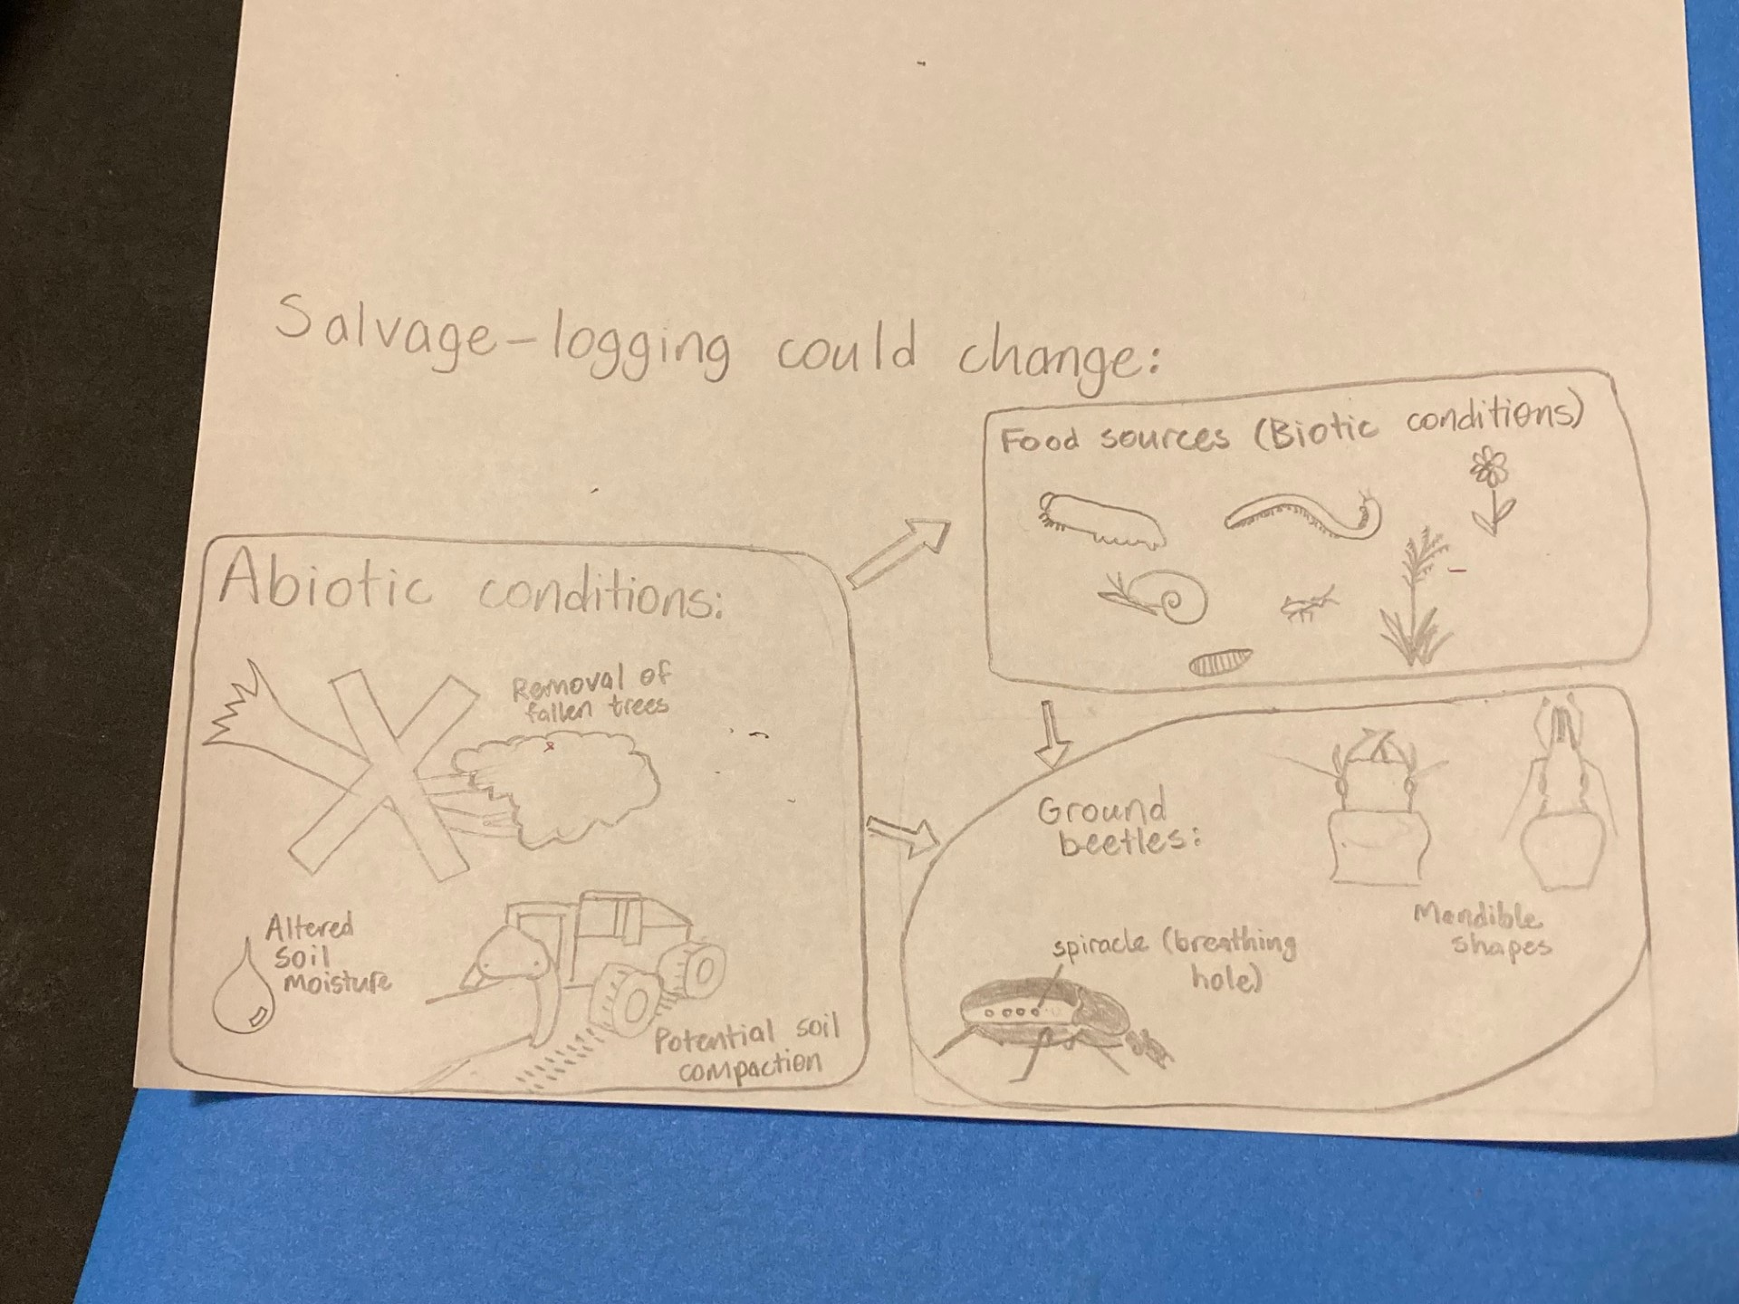

Slide 7
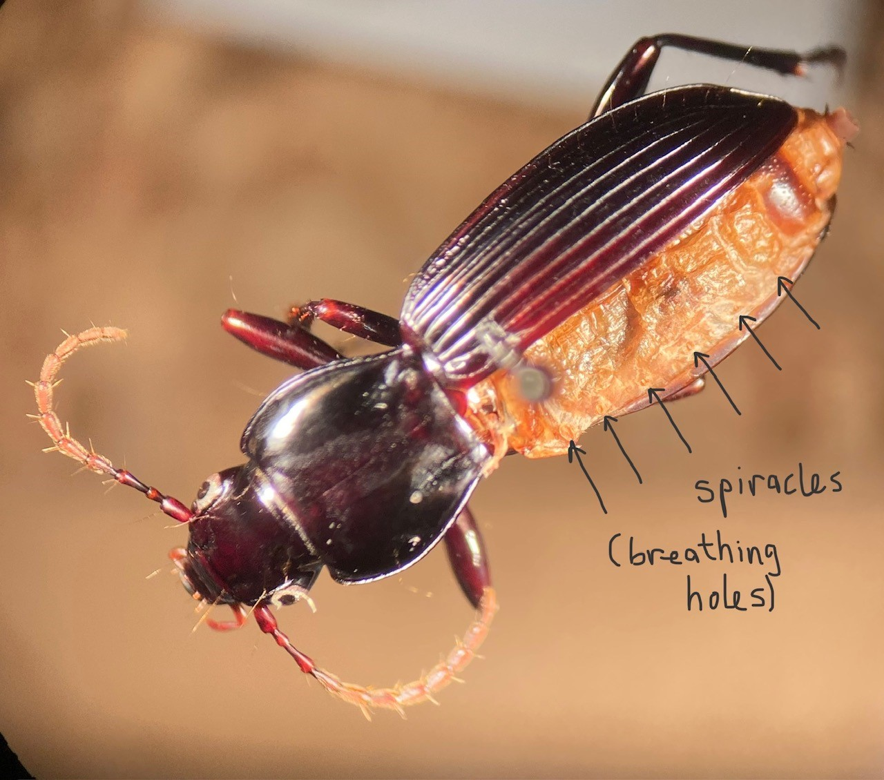

Slide 8
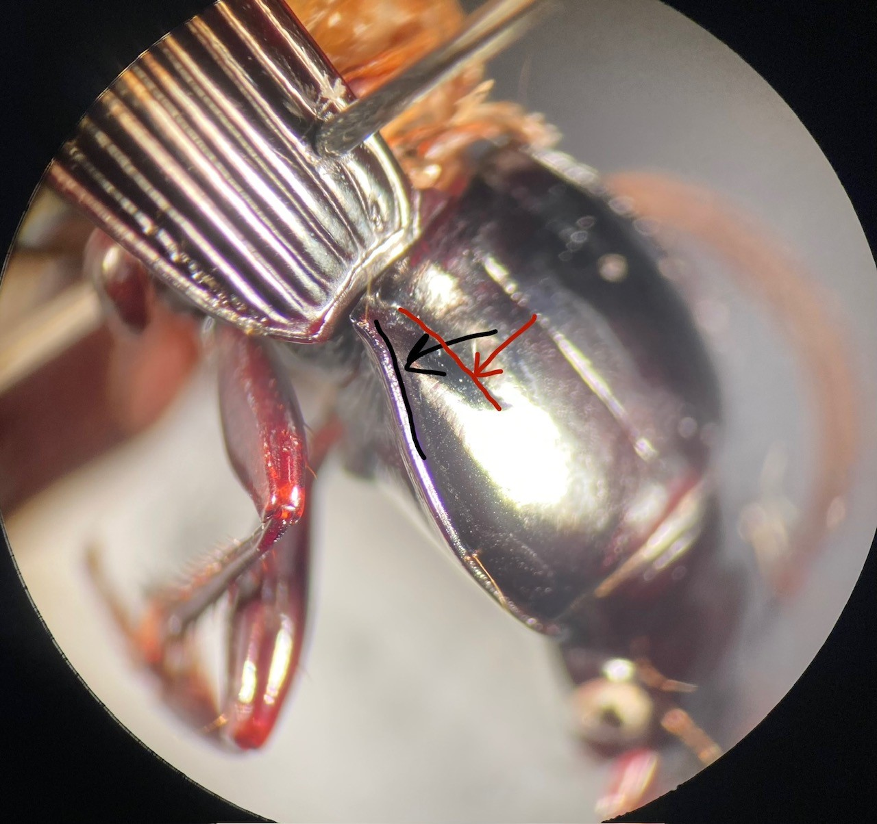

Slide 9
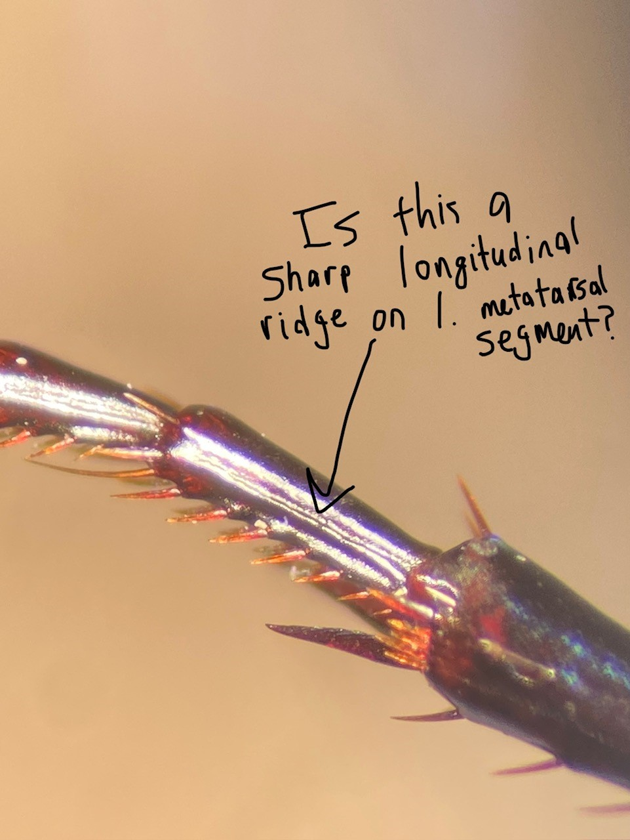

Slide 10
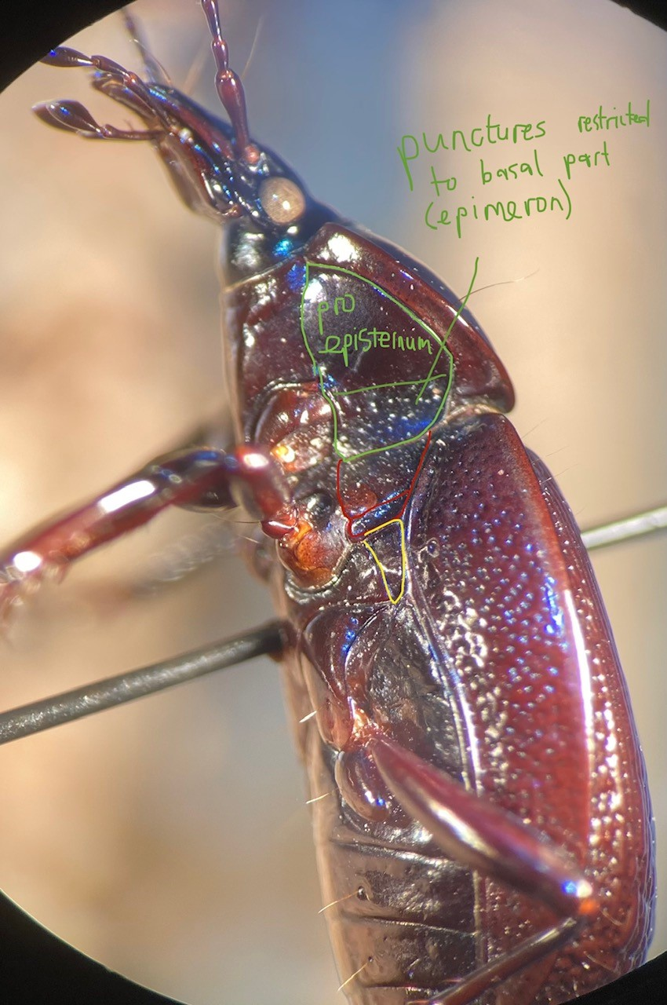

Slide 11
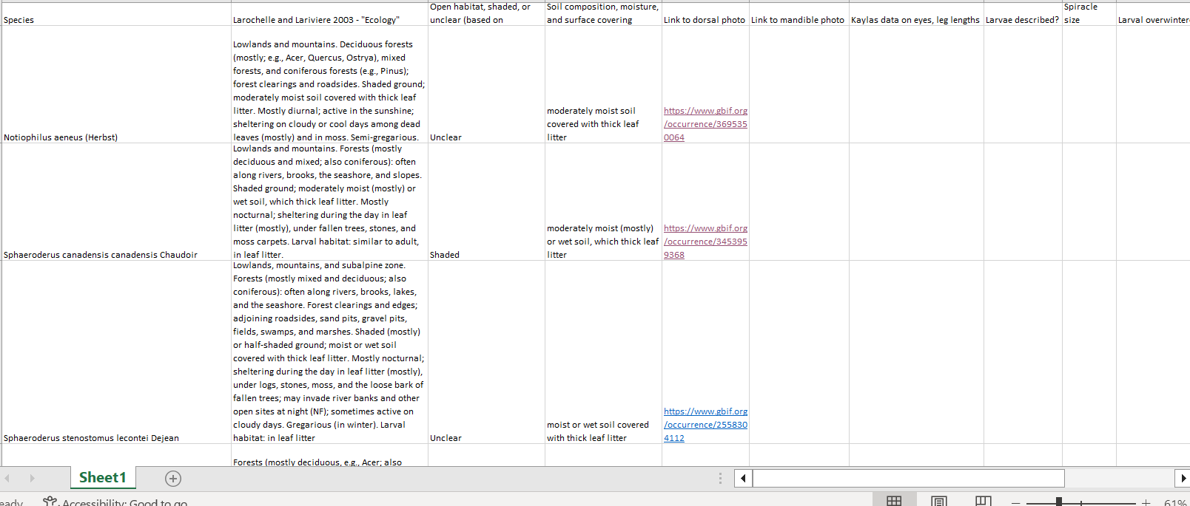

Slide 12
